Slide 1

Acting on Family Survey Results
Taking Action at Your School

Slide 2
Accessing Family
Survey Results

Slide 3
About the Washoe Family Climate Survey
Collect family feedback for formative growth
Results and resources

Slide 4
Example Topics
Family Efficacy:
How confident families are with regard to key parenting skills.
School Fit:
Families’ perceptions of how well a school matches their child's developmental needs.
Learning Behaviors:
Families’ perceptions of their child's learning-related behaviors.
Physical Safety:
Families’ perceptions of the overall physical safety of their child’s school
Relationships / Respect:
Families’ perceptions of how well school staff care for their child

Slide 5
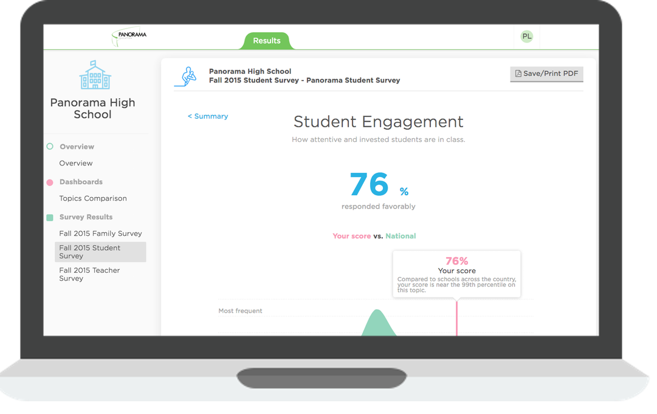
How Can I See Results?
Visit: secure.panoramaed.com
Log in with your username and password, or select “Forgot Password”.
School Fit

Slide 6
Respond to Family Voice at Your School

Slide 7
Next Steps for Schools
Explore and Reflect
Set the Tone
Guide Community Reflection
Define a School-Wide Focus
Enrich Adult Learning
1
2
3
4
5

Slide 8
Next Steps for Schools
Explore and Reflect
Set the Tone
Guide Community Reflection
Define a School-Wide Focus
Enrich Adult Learning
1
2
3
4
5

Slide 9
Reflect privately.
What do you predict the data the data will say?

Slide 10
What beliefs or assumptions drive those predictions?

Slide 11
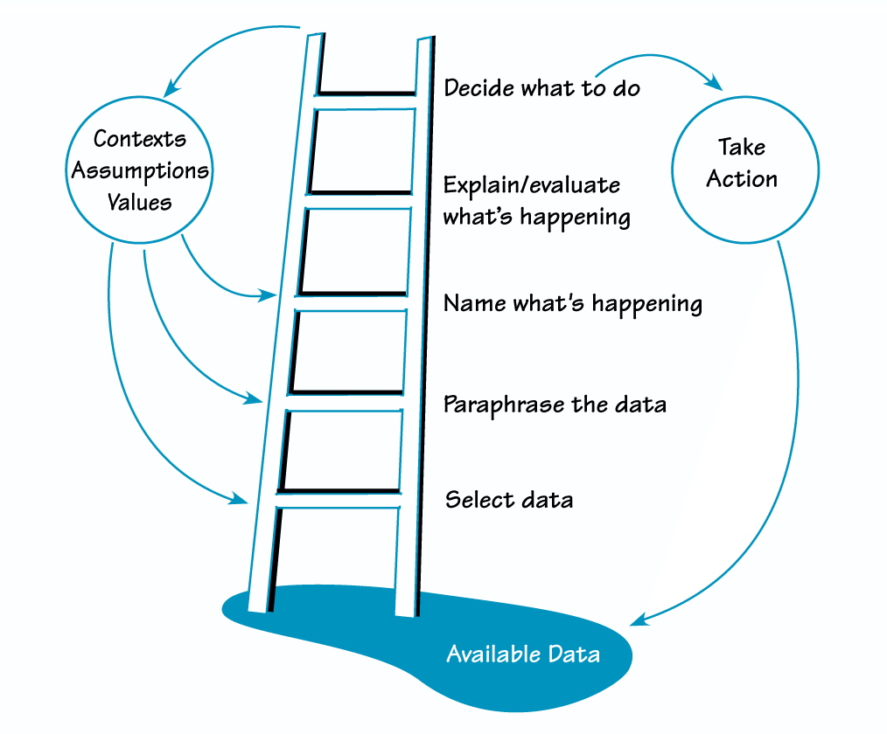
Ladder of Inference
Understanding the ladder allows us to use it as a tool; we can force ourselves to check our assumptions by starting at the bottom rung systematically climbing toward action.
Notes:
P

Slide 12
As you look through data...
What are alternative explanations for why ______ is happening?
What is the chain of reasoning that might have caused _____ to _______?
What are 3 questions I can generate to learn more before taking action?
Notes:
P

Slide 13


As you discuss data with others...
Sounds Like...
I notice...
I wonder...
Tell me more about your reasoning there...
Here are 3 possible reasons why…
Be Mindful Of…
______ always…
______ never…
[Evidence] must be false because…
Notes:
P

Slide 14
Note Your Observations
Note observations about the data that you see.
Remember the Ladder of Inference, and to stick with judgement-free noticings first. Try sentence starters such as:
I observe…
Patterns I notice…
I can count…
I’m surprised that I see…

Slide 15
Draw Inferences
Engage in data-driven dialogue to draw inferences with a colleague. Use the following steps to guide your discussion:
I believe the data suggests…because…
Additional data that would help would be…
We should respond by….
We’ll know if we’re improving when…

Slide 16
Next Steps for Schools
Explore and Reflect
Set the Tone
Guide Community Reflection
Define a School-Wide Focus
Enrich Adult Learning
1
2
3
4
5

Slide 17
Ladder of Inference
Understanding the ladder allows us to use it as a tool; we can force ourselves to check our assumptions by starting at the bottom rung systematically climbing toward action.
Notes:
P

Slide 18
What: Set the Tone
When looking at family perception data, you are now listening for the voices of your families.
Take time to frame data points as just that--verbal statements from families.
  90% of families responded favorably to the question: My child is treated fairly by all teachers and staff, no matter his or her race, cultural, or family background.
  Most families believe that their child’s school is equitable, but some families are telling us we need listen and learn more about their experiences.

Slide 19
Practice: Set the Tone
Identify a data point from Family Climate reports that reflects a broad area for growth across your school.
Record that data point in technical terms on the left.
On the right, interpret that data as voice.
Data from Panorama Reports | Family Voice Translation

Slide 20
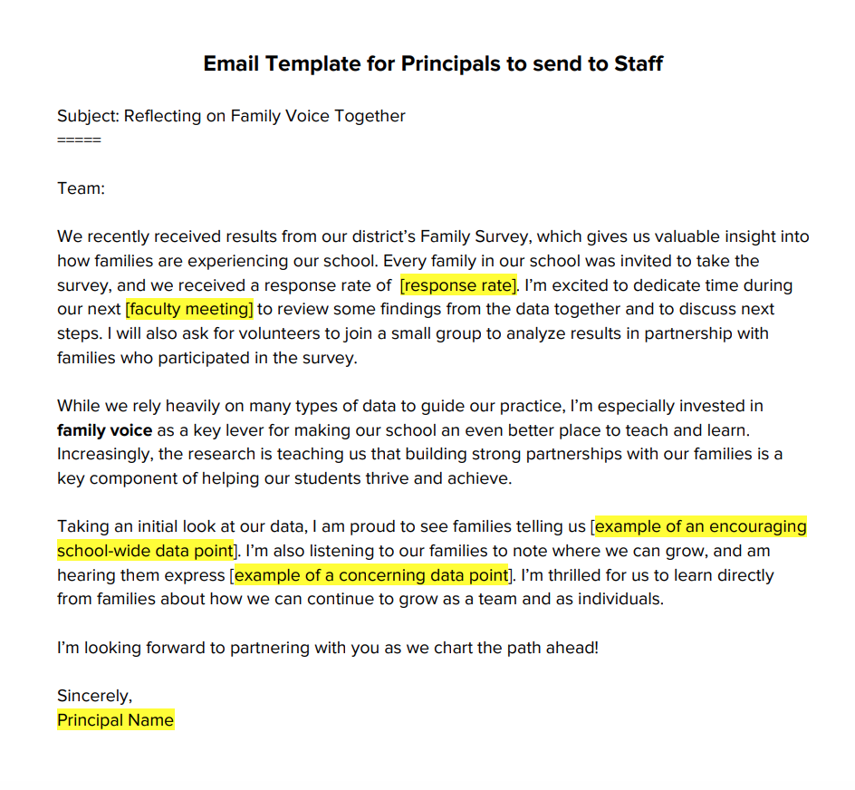
Email Template: From the Principal
Craft an email for faculty sharing your vision for how the Family Survey can help all staff respond to families directly, or customize this template.
Incorporate some of your reflections on school level results into communications.
secure.panoramaed.com
secure.panoramaed.com
secure.panoramaed.com

Slide 21
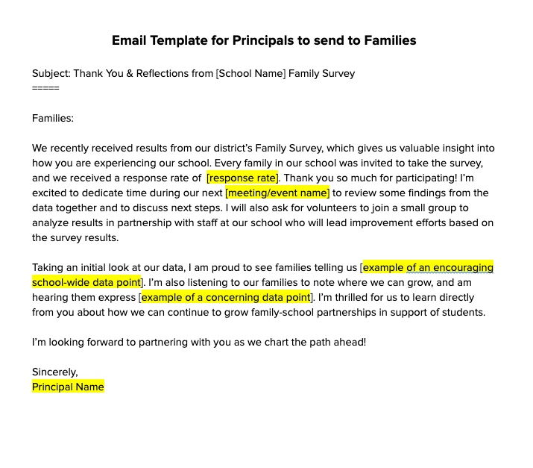
Email Template: From the Principal
Craft an email for families themselves outlining your school’s takeaways from their feedback. Use this template as a starting place and then customize it for your school.
Incorporate some of your reflections on school level results into communications.
secure.panoramaed.com
secure.panoramaed.com
secure.panoramaed.com

Slide 22
How: Set the Tone
Emphasize the formative nature of family perception data at your school, that results are a non-evaluative tool to drive continuous reflection and growth.
Share more with your staff about how strong family-school partnerships can drive student outcomes.

Slide 23
Next Steps for Schools
Explore and Reflect
Set the Tone
Guide Community Reflection
Define a School-Wide Focus
Enrich Adult Learning
1
2
3
4
5

Slide 24
What: Guide Community Reflection
Bring a small, representative group of 10-20 staff and families together around school-level results from your most recent family survey reports.
  Option 1: Invite the group to discuss major takeaways or insights from your school-level results and generate ideas for how to guide improvement using a collaborative protocol.
  Option 2: Use Bookmarks to share school-wide points of pride and areas for growth with staff and families and encourage small group conversations about root causes and underlying next steps.

Slide 25
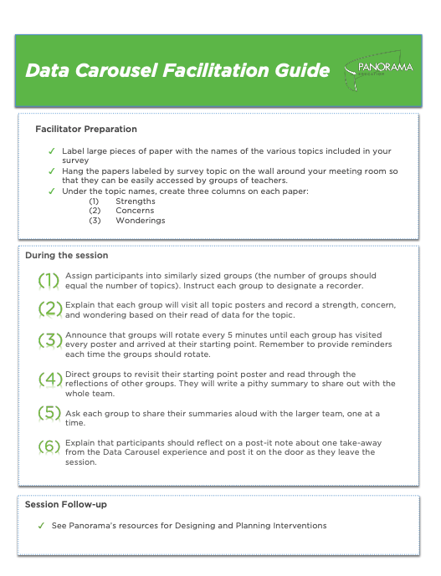
How: Guide Community Reflection
Invite a small group staff and families to participate in a school-level data debrief focused on family voice.
Ask staff to review school-level survey results in advance and come prepared to engage in discussion what families are telling us, and what they might be asking us to do.
Consider using a protocol to drive community-wide reflection, like a Data Carousel.

Slide 26
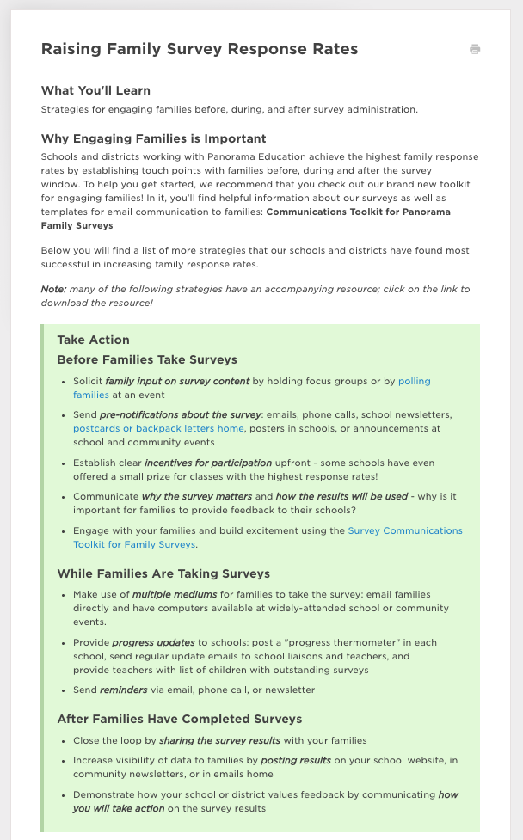
Strategize to Increase Participation
As part of community reflection, be sure to note response rates and any opportunity for increasing participation and representativeness of your results.
Discuss as a group which strategies you will implement to increase participation during your school’s upcoming survey administration. Consider setting a school-wide goal for participation so that you can accurately gauge progress towards your goals.

Slide 27
Next Steps for Schools
Explore and Reflect
Set the Tone
Guide Community Reflection
Define a School-Wide Focus
Enrich Adult Learning
1
2
3
4
5

Slide 28
What: Define a School-Wide Focus
Following up on collaborative discussion facilitated during your community-wide debrief on survey results, assemble a group of leaders to determine a focus area for your school.
Work with teachers, families, and other administrators to identify strategies aligned to your area of focus, and incorporate modeling and practice of those strategies into staff meeting and professional learning time.

Slide 29
How: Define a School-Wide Focus
High Actionability
Low Impact
High Actionability
High Impact
Low Actionability
Low Impact
Low Actionability
High Impact
As you meet with members of your school team to sharpen your focus on one improvement area, consider a matrix of impact and actionability.
Depending on your context, consider aligning your response to survey results to a major priority in the upper right quadrant.

Slide 30
Next Steps for Schools
Explore and Reflect
Set the Tone
Guide Community Reflection
Define a School-Wide Focus
Enrich Adult Learning
1
2
3
4
5

Slide 31
How: Enrich Adult Learning
Consider empowering a small group of adults to model a learning orientation for colleagues around family voice, sharing their reflections and improvement goals for their practice.
Connect feedback and coaching on classroom instruction to family perceptions shared through the WCSD Family Climate Survey.
Encourage teachers to pursue professional development aligned to improving family partnerships.

Slide 32
Resources for Taking Action

Slide 33
Additional Resources
WCSD Family Engagement Website
Strategies for Fostering Family-School Partnership
The Panorama Facilitator’s Toolkit
The Top 5 Ways to Improve Family Response Rates
Measuring and Improving Family Engagement in Wake County Public School System
Parent-Teacher Conference Agenda
Engaging Parents about Feedback Surveys
Toolkit of Resources for Engaging Families and Community as Partners in Education (Credit to Regional Education Laboratory Program)
A Dual-Capacity Building Framework for Family-School Partnerships (Credit to Dr. Karen Mapp)
secure.panoramaed.com
secure.panoramaed.com
secure.panoramaed.com

Slide 34
Looking Ahead

Slide 35

Implementation Intentions
Let’s Discuss!
What are you most excited about?
What possible challenges do you anticipate, and how will you navigate them in practice?
secure.panoramaed.com
secure.panoramaed.com
secure.panoramaed.com

Slide 36
Thank You!

